Slide 1
Face Expression Recognition using Python

Slide 2
Introduction
Welcome to our presentation on "Deep Learning for Face expression detection using Convolutional Neural Networks (CNNs) and python"
We are excited to share our findings and insights on this topic with you today
In this presentation, we will introduce you to the concept of deep learning and CNNs
We will explain how CNNs are used for Face expression detection and their advantages over traditional machine learning algorithms
We will also discuss a specific implementation of a CNN for Face expression detection using the Keras library in Python

Slide 3
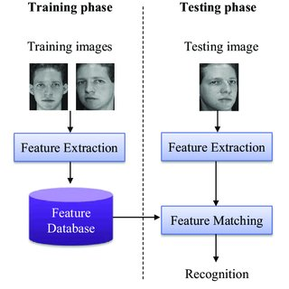
Work Flow

Slide 4
Deep Learning
Deep learning is a subset of machine learning that involves training neural networks with multiple layers to learn patterns and features from data
It has revolutionized the field of artificial intelligence and has been used to achieve state-of-the-art results in various applications, including Face expression detection.

Slide 5
Convolutional Neural Networks
Convolutional Neural Networks (CNNs) are a type of neural network designed for Face expression detection tasks
They consist of multiple layers of convolutional and pooling operations, followed by fully connected layers
CNNs can learn to identify features such as edges, shapes, and textures of face, making them highly effective for face classification tasks

Slide 6
Advantages of CNNs
CNNs have several advantages over traditional machine learning algorithms for face expression detection :
They can learn features automatically from raw image data, reducing the need for hand-crafted features
They are highly scalable and can handle large datasets
They can learn hierarchical representations of features, making them more effective at face expression detection tasks

Slide 7
Implementation of CNN for face expression detection
In this presentation, we will discuss a specific implementation of a CNN for face expression detection using the Keras library in Python
We will explain the steps involved in loading and preprocessing the data, defining the CNN architecture, training and evaluating the model, and analyzing the results

Slide 8
Motivation
Through this project, we aimed to explore different machine learning models and techniques for face expression detection and to gain a deeper understanding of their strengths and limitations. We also wanted to apply our knowledge and skills in machine learning to a real-world problem and create a useful and applicable solution.
We hope that our project can serve as a valuable learning opportunity for all of you, as we share our experiences and insights on model design approaches and result interpretations in machine learning.

Slide 9
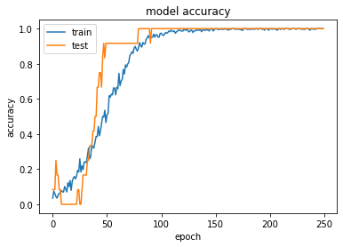
Model

Slide 10
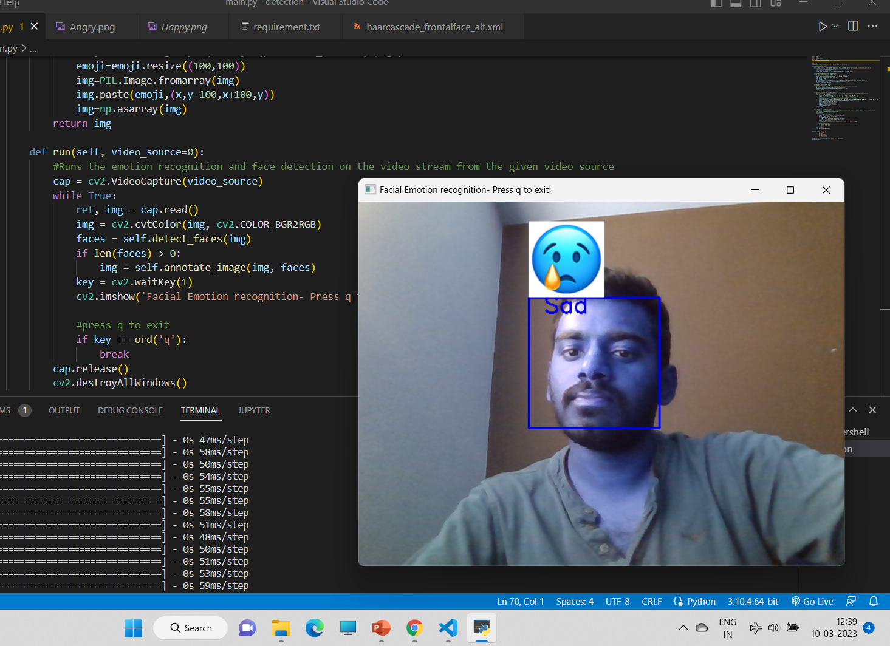
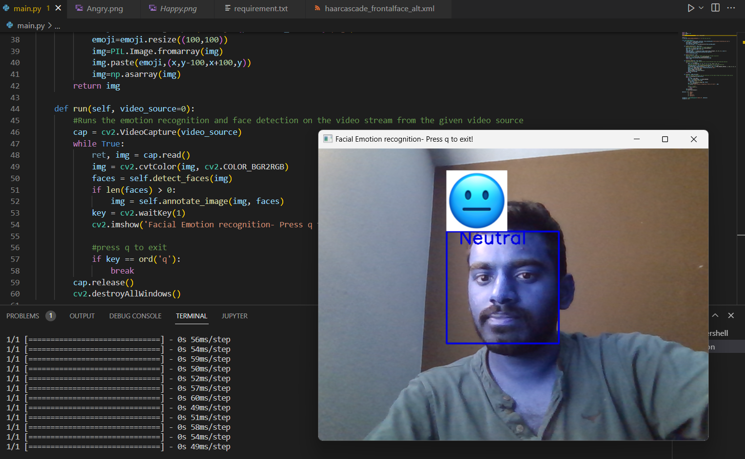
Output

Slide 11
Conclusion
I'm here to present our project on machine learning techniques. Our project was motivated by the desire to explore various machine learning models and their applications. We wanted to gain a deeper understanding of the design approaches and result interpretations of these models.
In our pursuit, we used various machine learning techniques, including linear regression, decision trees, and neural networks. We acquired data from various sources and used it to train and test our models. Our project was focused on predicting face expression detection.
In terms of model design, we paid particular attention to feature engineering and regularization techniques to improve the performance of our models. We also experimented with various hyperparameters to optimize the performance of our models.
Moving forward, we believe that our project can serve as a starting point for future work in predicting image classification using machine learning techniques. We encourage others to build on our work and explore different models and approaches to improve the accuracy of face expression detection .
Thank you for listening, and we hope you found our presentation informative.
Git link Git

